Slide 1
Word Vectors
Chien Chin Chen
Department of Information Management
National Taiwan University

Slide 2
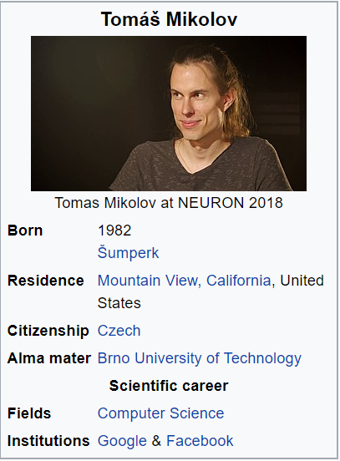
When He was an Intern …
In 2012, Thomas Mikolov, an
intern at Microsoft, found a way
to encode the meaning of words
in a modest number of vector
dimensions.
In 2013 (at Google), Mikolov and his teammates released Word2vec.

Slide 3
Overview
He trained a neural network to predict word occurrences near a target word.
The weights of the network that help represent words!!
Basically, it is a language modeling problem!!
It is unsupervised learning that the prediction is based on a super large corpus of unlabeled text.
Or … supervised … but the labeling has been done already!!

Slide 4
Two Approaches
Two approaches to train the prediction model (language model).
Skip-gram: predicts the context of words from a word of interest.
Continuous bag-of-words (CBOW): predicts the target word from the nearby words.

Slide 5
Skip-gram Approach (1/9)
In skip-gram, you (the model) are trying to predict the surrounding window of words based on an input word.
The neutral network consists of two layers of weights.
The hidden layer consists of n neurons.
n is the number of vector dimension used to represent a word.
The input and output layers contain m neurons.
m is the number of words in the vocabulary.
Note that the output layer uses softmax as an activation function.
w_{t-2}, w_{t-1} w_{t+1} w_{t+2} : the surrounding words
Claude Monet painted the Grand Canal of venice in 1908.
w_{t}: the input word

Slide 6
Skip-gram Approach (2/9)
The prediction (testing) phase of the model:
Claude
0
0.006
Claude
Monet
0
0.004
Monet
painted
1
0.001
painted
the
0
0.967
the
…
…
…
drew
0
0.001
drew
sketched
0
n hidden neurons
0.001
sketched
m inputs
one-hot vector for words
m outputs

Slide 7
Skip-gram Approach (3/9)
How to train the prediction model?
You need a text corpus.
Suppose the window size of the context is 2.
Process every token in the corpus to produce a set of training word pairs:
Claude Monet painted the Grand Canal of venice in 1908.
input word | expected output word
…
painted | Claude
painted | Monet
painted | the
painted | grand
…

Slide 8
Skip-gram Approach (4/9)
Randomly initialize the network (weights):
Claude
Claude
Monet
Monet
painted
painted
the
the
…
…
…
drew
drew
sketched
n hidden neurons
sketched
W_{mxn}: weight matrix
W’_{nxm}: weight matrix
Initialize the weight matrices

Slide 9
Skip-gram Approach (5/9)
The objective of the model (the weights) is to make a correct prediction of each training word pair!!
Training pair: {painted, the}
Claude
0
0.006
Claude
Claude
0
0.006
Claude
Monet
0
0.004
Monet
Monet
0
0.004
Monet
painted
1
0.001
painted
painted
1
0.001
painted
the
0
0.001
the
the
0
0.983
the
…
…
…
…
…
…
drew
0
0.954
drew
drew
0
0.001
drew
sketched
0
n hidden neurons
0.001
sketched
sketched
0
n hidden neurons
0.001
sketched
m inputs
m outputs
m inputs
m outputs
Bad weights…
Good weights…

Slide 10
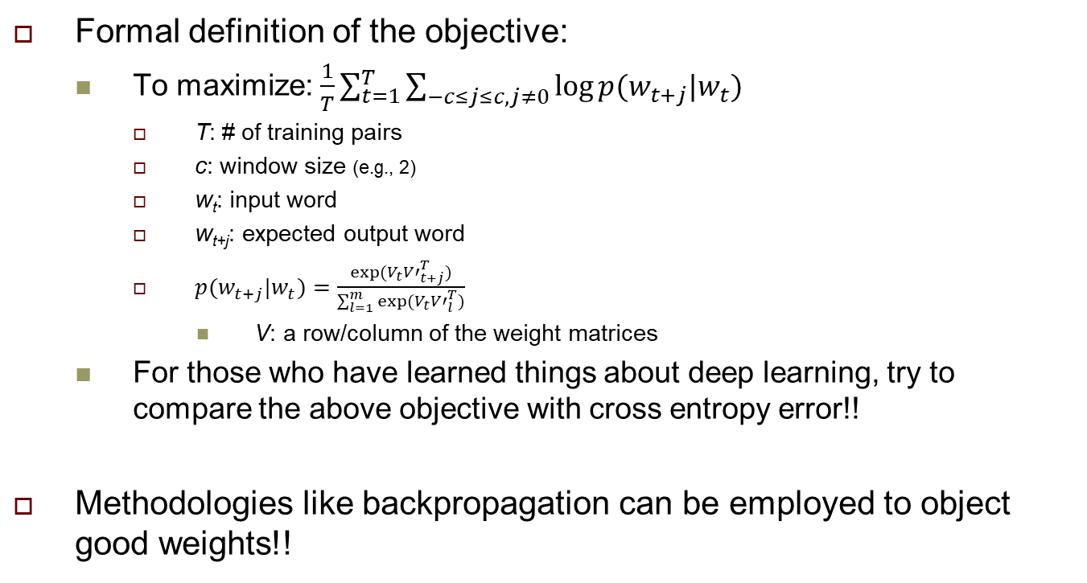
Skip-gram Approach (6/9)
Formal definition of the objective:
To maximize: $\frac{1}{T}\sum_{t=1}^{T}{\sum_{−c≤j≤c,j≠0}{log⁡p(w_{t+j}|w_{t})}}$
T: # of training pairs
c: window size (e.g., 2)
w_{t}: input word
w_{t+j}: expected output word
$p(w_{t+j}|w_{t})=\frac{exp⁡(V_{t}{V′}_{t+j}^{T})}{\sum_{l=1}^{m}{exp⁡(V_{t}{V′}_{l}^{T})}}$
V: a row/column of the weight matrices
For those who have learned things about deep learning, try to compare the above objective with cross entropy error!!
Methodologies like backpropagation can be employed to object good weights!!

Slide 11
Skip-gram Approach (7/9)
After training, the weight matrix W is your word embedding.
Claude
Claude
Monet
Monet
painted
painted
the
the
…
…
…
drew
drew
sketched
n hidden neurons
sketched
W_{mxn}: weight matrix
Claude
0.3 | 0.07 | -0.02 | … | 0.61
Every word now can be
represented as a n-dim
embedding vector!!
Monet
painted
…

Slide 12
Skip-gram Approach (8/9)
WHY?
The prediction is like a function!!
Claude
0
0
Claude
T
T
0.3
0.07
-0.02
…
0.61
0
0
0
1
…
0
0
0.3
Monet
0
0
Monet
0.07
W’
=
painted
1
0
painted
the
0
-0.02
1
the
…
…
…
input’s embedding
drew
0
0.61
0
drew
sketched
0
n hidden neurons
0
sketched
W_{mxn}: weight matrix
Claude
0.3 | 0.07 | -0.02 | … | 0.61
Monet
painted
…

Slide 13
Skip-gram Approach (9/9)
Semantically similar words (synonyms) will have similar vectors!!
Because they were trained to predict similar surrounding words!!
Or … they would form similar training pairs!!
Training dataset: {painted, Claude} {painted Monet} … {sketched, Claude} {sketched, Monet} …
0.3
0.07
-0.02
…
0.61
1
0
0
0
…
0
0
painted’s embedding
W’
=
?
?
?
…
?
0.28
0.05
-0.04
…
0.58
What about sketched’s embedding?

Slide 14
CBOW
Predict the center word based on the surrounding words.
Claude
1
0.003
Claude
Monet
1
0.001
Monet
painted
0
0.952
painted
the
1
0.001
the
Grand
1
…
…
0.001
drew
…
sketched
0
n hidden neurons
0.001
sketched
m inputs
multi-hot vector for words
m outputs

Slide 15
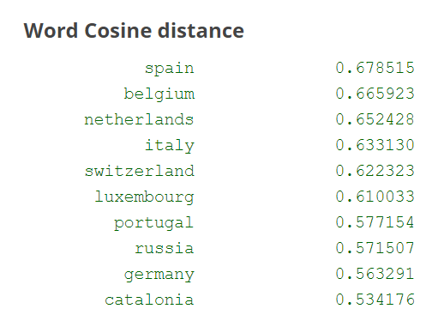
Use of Embeddings
Find close words
Cosine similarity of vectors.
Words close to “France”
Inputs of sophisticate deep learning networks
Reasoning the relationships between words
V_{San_Francisco} – V_{california} + V_{colorado} = V_{Denver}
V_{king} – V_{man} + V_{woman} = V_{queen}
Example provided by Google word2vec project

Slide 16
Which Approach is Better?
Mikolov highlighted:
Skip-gram works well with small corpora and rare terms.
CBOW shows higher accuracies for frequent words and is much faster to train.
Some studies show skip-gram is better…

Slide 17
Pretrained Models
The computation of the word vectors can be resource intensive!!
Luckily, for most applications, you won’t need to compute your own word vectors.
Google provides a pretrained Word2vec model based on English Google News articles.
https://code.google.com/archive/p/word2vec/
Facebook published pretrained fastText models for 294 languages!!
But if your application relies on specialized vocabulary, you will need to train word vectors on text from your application domain.

Slide 18
What about Doc2vec? (1/2)
The concept of word2vec can also be extended to sentences, paragraphs, or entire documents.
The prediction of the target word(s) considers not only the previous words, but also the vector representing the document.
document₁: Claude Monet painted the Grand Canal of venice in 1908.
document₂: Once upon a time, ….
Inputs | expected output word
{d₁, painted} | Claude
{d₁, painted} | Monet
{d₁, painted} | the
{d₁, painted} | grand
…

Slide 19
What about Doc2vec? (2/2)
Claude
0
0.006
Claude
Monet
0
0.004
Monet
painted
1
0.001
painted
the
0
0.967
the
…
…
…
drew
0
0.001
drew
n hidden neurons
sketched
0
0.001
sketched
k hidden neurons
d₁
1
d₂
0
k can be different to n!!
d₃
0
…
…
W’’_{Lxk}: weight matrix,
contain the embeddings of the documents
d_{L}
0

Slide 20
Other Issues
Train stop words or not?
Stop words should not be completely ignored or skipped while training your word vectors.
We have so many parameters to learn.
Negative sampling and hierarchical softmax
New techniques: GloVe and BERT
What about Item2Vec?

